Slide 1
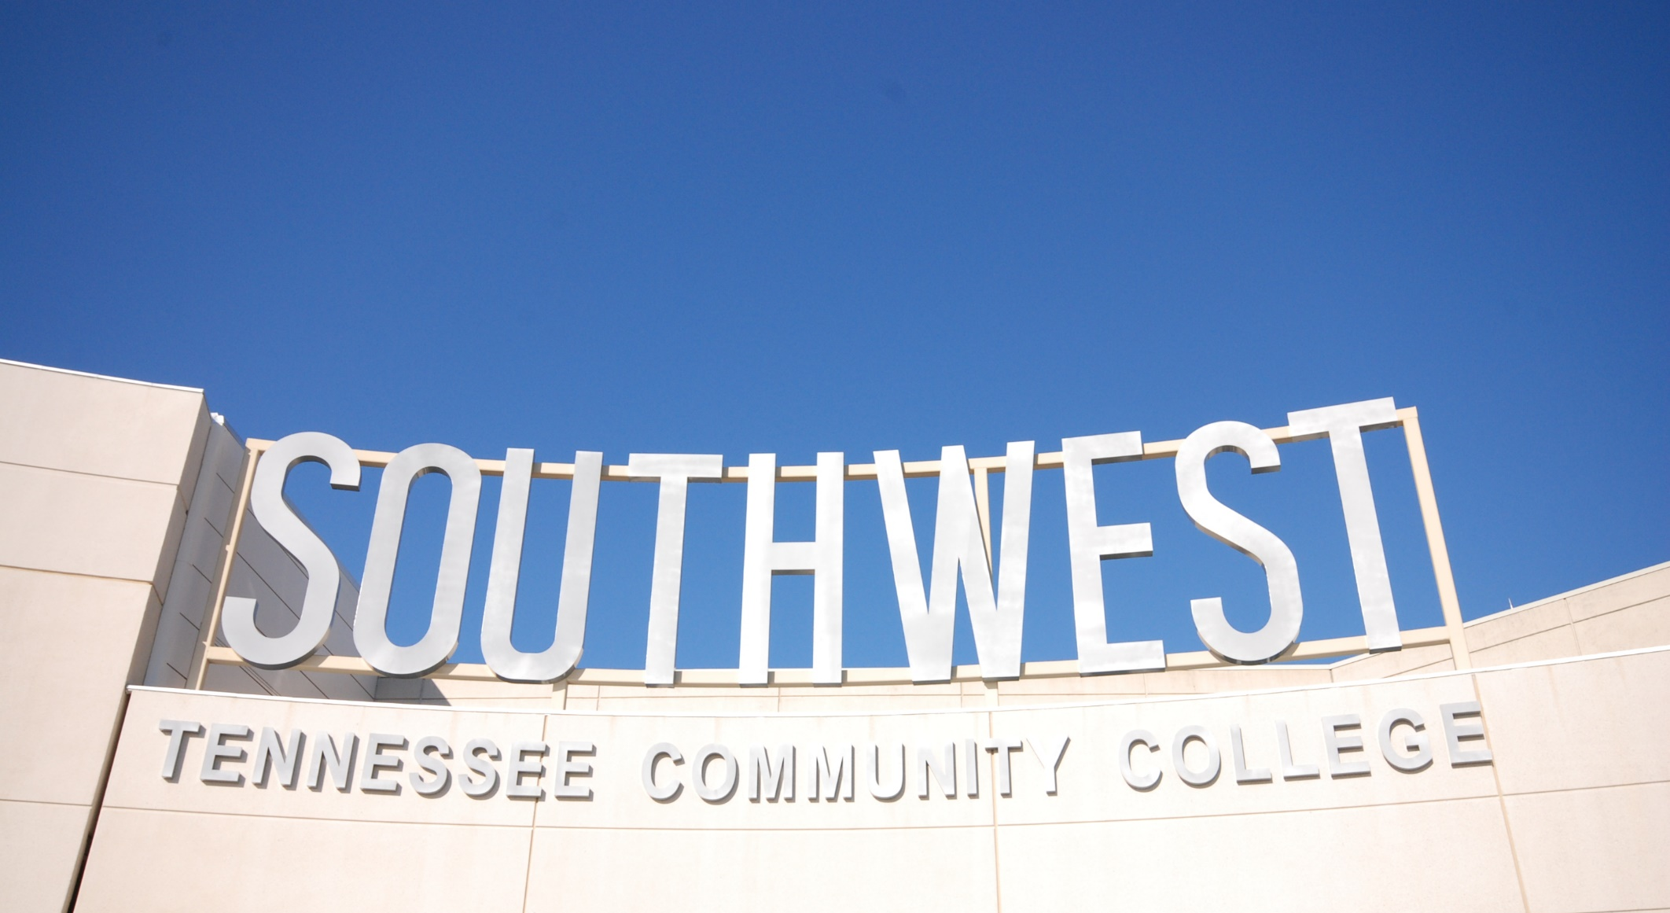
ADMINISTRATIVE SERVICES
Michael D. Boyd
Chief of Administrative Services
Board of Trustees Orientation
Presenter:
Dr. Tracy D. Hall, President
Southwest Tennessee Community College

Slide 2
ADMINISTRATIVE SERVICES
Physical Plant
ITS
Police Services
IT Security
Executive Directive Vacant
Deputy CIO
Vacant
Executive Directive Greenleaf
Director Sorrell

Slide 3
Police Services and Risk Management
Police Services
Risk Management
S.E.R.T.

Slide 4
Physical Plant
Custodial
Maintenance
Shipping & Receiving
Mail Services
Fleet Services & Car Reservations
Event & Space Management
HVAC , Plumbing, & Electrical
Landscaping
Environmental Health & Safety
Capital & Improvement Projects
Surplus
Furniture
Facilities Project Management
Moving Services
Utilities & Fuel Services

Slide 5
INFORMATION TECHNOLOGY SERVICES
Client/Media Services
Enterprise Application Services
Technology Operations
Help Desk, Switchboard and Telephony

Slide 6
Current EAS Projects
SLATE
Slate is more than just a Customer Relationship Management application, it is a customizable platform for Admissions and Student Success.
Slate is replacing:
Banner Self Service 8 Admissions Applications
EAB Navigate

Slide 7
Current EAS Projects
The SLATE project kickoff was in December 2023.
SLATE module 2024 go live dates:
Joint Inquiry form for degree seeking and Workforce students in April
Student Success module in May.
Admissions module in June.
The implementation team includes members of Enterprise Application Services, Student Affairs, Academic Affairs and Workforce Development.

Slide 8
Current EAS Projects
Banner 9 Self Service
Human Resources, Finance Budget and Payroll are wrapping up testing.
Student registration module is in the configuration stage
Watch for announcements on go live parallel operations for Banner 8 Self Service and our new Banner 9 Self Service.

Slide 9
Current EAS Projects
My.Southwest portal and mobile app
Project initiation for the upgrade of our portal and mobile app is underway.
The upgrade will introduce new functionality and a new look and feel to these applications.

Slide 10
Police Services/Public Safety
Executive Director
Ernest A. Greenleaf, Sr.
egreenleaf@southwest.tn.edu
Associate Director
John E. Mitchell
jmitchell34@southwest.tn.edu

Slide 11
Police SERVICES
Southwest police officers are sworn by the State of TN with full arrest powers.
STCC Police enforce policies and laws, respond to criminal activity, and investigate crimes on campus.
STCC Police provide escorts
STCC Patrols on foot and by marked STCC police vehicles.
STCC Police Services also employ student workers known as Campus Safety Technicians to act as another set of eyes and ears.
STCC POLICE OFFICERS ARE NOT SECURITY GUARDS

Slide 12
Location Contact Information
Gill 901-333-5975 Room #105
Macon 901-333-4242 Nabors Building #101
Maxine Smith 901-333-6045 Room #112
Whitehaven 901-333-6479 Room #100A
Union 901-333-5555 Parrish Building #107

Slide 13
SOUTHWEST CAMPUS SAFETY MEASURES
Campus Safety Technician Program
New camera system that monitors all campuses
SERT team – a trained group on campus to assist police with emergencies
BETA Team: A group that investigates and acts on disruptive behavior
Rave: An emergency messaging system
Rave Guardian app: Electronic escort/monitoring
Emergency phones
Police escorts upon request
Armed intruder, fire, and dangerous weather-related drills.
License plate readers on each campus

Slide 14
Tips While Walking
Avoid traveling alone at night.
Confine walking to well-lit, regularly traveled walks and pathways. Avoid shortcuts and keep away from shrubbery, bushes, alleyways, or any other areas where an assailant might be lurking.
Avoid isolated areas after dark.
Do not accept rides from casual acquaintances.
When walking to your vehicle, have your keys ready in hand.
When being dropped off by ride share or private vehicle, ask the driver to wait until you get inside.
If threatened by an approaching vehicle, run in the opposite direction. The vehicle will have to turn around in order to pursue you.
When getting out of a car, take a look around to make sure that you are not being followed.

Slide 15
Tips while walking continued
If you think you are being followed, cross the street and, if necessary, keep crossing back and forth. If you are pursued, call for help and run to a campus building, business or residence, enlist the aid of a passerby, or flag down a passing motorist. Do anything that might attract attention or summon assistance. If you are walking alone and someone passes you, check to be sure that person has continued walking in the other direction.
Call the Police Services/Public Safety office for an escort if walking alone at night.
If you find yourself confronted by an assailant, you must remember that while screaming and struggling may, in some instances, frighten off the assailant, in other instances, you may further antagonize the assailant and bring forth a more violent reaction. Above all, you must keep your head and assess the situation before choosing your course of action. Whether or not the assailant is armed or has made threats against your life should be a determining factor in your decision. The key word in this type of situation is survival.
Use the Rave Guardian app

Slide 16
Information Security Purpose
STCC’s Objective is Educating Students
Info Security is in business to ensure student and other sensitive information is properly secured to the extent possible
Primarily managed via calculated Risk Management.

Slide 17
Recent Spam Email Techniques
New method using cell phone calls
Recent spam tests from latest campaign
Tips to follow:
Taking a minute to look for reasonability
Keys --- a. Document name. b. Email address
c. Hover test for real document name.

Slide 18
AI & Cyber Security

Slide 19
Union Library

Slide 20
Union Library

Slide 21
Union Library

Slide 22
Union Library

Slide 23
Union ABC Corridor

Slide 24
Important Information
DUO
Rave Alerts
Rave Guardian
901-333-HELP (4357)
How to create a ticket
www.southest.tn.edu > Staff Resources > Physical Plant Service Request(Dude Solutions)
www.southest.tn.edu > Staff Resources > Help Desk (Quick Ticket)

Slide 26
THANK YOU!
@SouthwestTN

